Slide 1
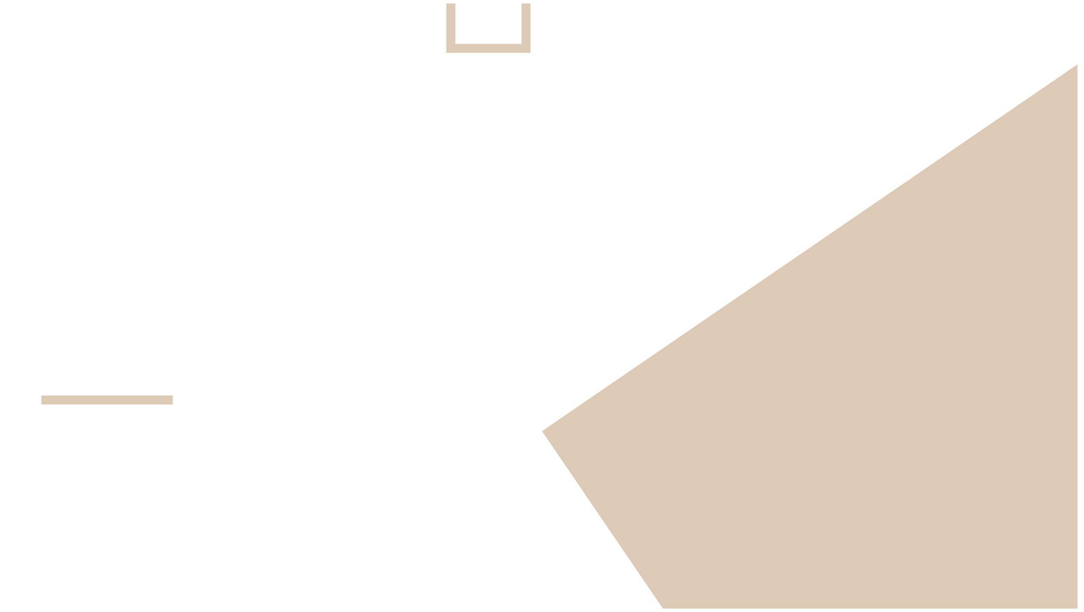

Mastering Problem-Solving Skills
Suez Canal University Session 8-03-2025

Slide 2


This presentation focuses on developing and enhancing problem-solving skills, applicable across various contexts.

Slide 3
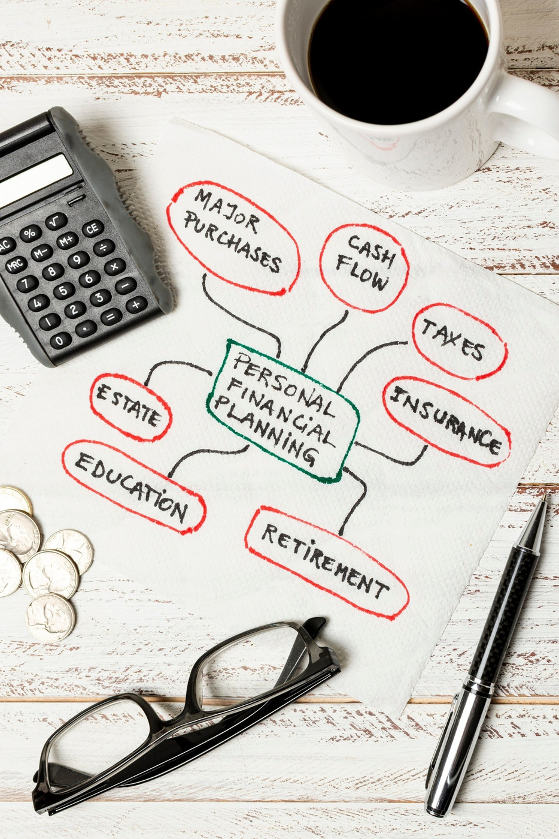
Problem-solving is the process of identifying challenges, analyzing them, and implementing efective solutions. It involves critical thinking, creativity, and collaboration to navigate complex issues in the workplace.

Slide 4
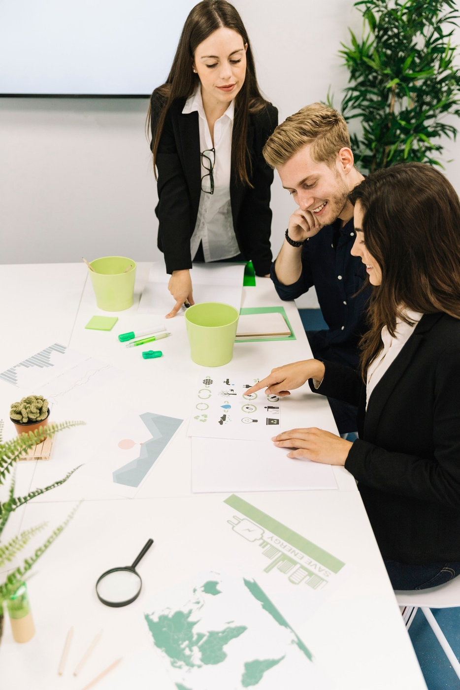
Defining the Challenge
  A problem is a situation that presents a difficulty or requires a solution.
  Problems can range from simple everyday challenges to complex strategic issues.
  Recognizing and defining the problem is the first crucial step.

Slide 5

The Problem Landscape
  Well-defined problems: Clear situation, known information, and obvious solutions.
  Not-defined problems: Ambiguous situation, missing information, and multiple potential solutions.
  Routine problems: Recurring problems with established solutions.
  Novel problems: New and unique problems requiring creative solutions.

Slide 6

A Structured Approach
  Identify the Problem: Clearly define the issue.
  Analyze the Problem: Gather information and understand the root causes.
  Generate Potential Solutions: Brainstorm a range of possible solutions.
  Evaluate Solutions: Assess the pros and cons of each solution.
  Choose the Best Solution: Select the most effective and feasible option.
  Implement the Solution: Put the chosen solution into action.
  Evaluate the Outcome: Assess the results and make adjustments as needed.

Slide 7

Understanding Design Thinking
Design thinking is a human-centered approach to problem-solving, innovation, and creation.
It's a process that emphasizes understanding the needs of the user, challenging assumptions, and rapidly prototyping and testing solutions.

Slide 8

Core Principles
  Human-centered: It's about understanding their needs, behaviors, and motivations to create solutions that truly resonate with them.
  Empathic: The ability to understand and share the feelings of others.
  Iterative: A cycle of learning and improvement. Solutions are prototyped, tested, and refined based on feedback, leading to better outcomes.
  Collaborative: Involves cross-functional teams, bringing together diverse perspectives and expertise to generate more creative solutions.
  Experimental: Encourages experimentation and prototyping.
  It's about learning by doing and testing ideas in a tangible way.

Slide 9

The Design Thinking Process
  Empathize: Understanding the user's needs and context through research, interviews, and observation.
  Define: Clearly articulating the problem or opportunity based on the insights gathered during the empathize stage.
  Ideate: Generating a wide range of potential solutions through brainstorming, sketching, and other creative techniques.
  Prototype: Creating simplified versions of solutions to test and gather feedback.
  Test: Evaluating prototypes with users to identify what works and what needs improvement.

Slide 10

Benefits of Design Thinking
  Innovation: Design thinking fosters creativity and helps generate innovative solutions that address real user needs.
  User-centricity: By focusing on the user, design thinking ensures that solutions are relevant and valuable.
  Problem-solving: Design thinking provides a structured framework for tackling complex problems in a systematic way.
  Collaboration: Design thinking encourages teamwork and collaboration, leading to better outcomes.
  Reduced risk: Prototyping and testing help identify potential issues early on, reducing the risk of costly mistakes.

Slide 11

  Measure the effectiveness of the solution: Did it solve the problem?
  Gather feedback: Get input from stakeholders on the results.
  Make adjustments as needed: Be prepared to iterate and refine the solution.

Slide 12

Avoiding the Traps
  Jumping to conclusions.
  Not defining the problem clearly.
  Focusing on symptoms rather than root causes.
  Resisting change.
  Lack of communication.

Slide 13
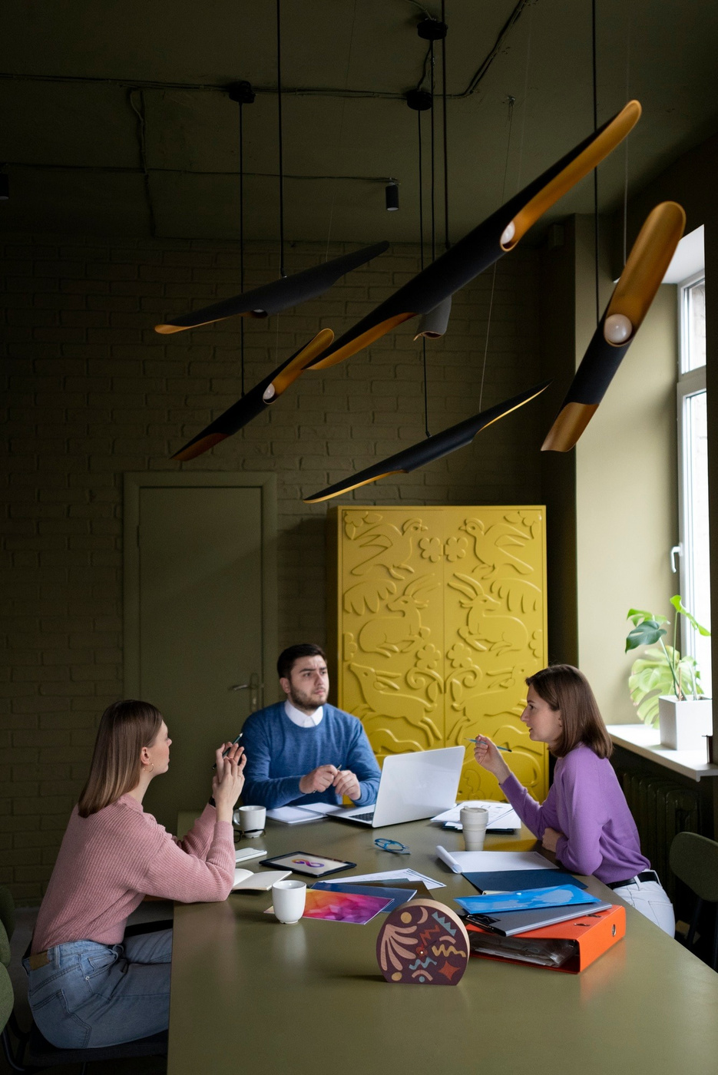
Sharpening Your Skills
  Practice: The more you solve problems, the better you'll become.
  Seek out challenges: Don't shy away from difficult situations.
  Learn from others: Observe how others approach problem-solving.
  Be open to new ideas: Embrace different perspectives and approaches.
  Reflect on your experiences: Analyze your successes and failures to learn and improve.

Slide 14
Thanks!
DO YOU HAVE ANY QUESTIONS?
mmounir.agawad@gmail.com
https://mamdouh-mounir.com/

